Slide 1
Kampong Ecommerce Data Analytics
AgilOne

Slide 2
Data Sources for analysis
The insights provided in this report is based on what we have analyzed from the following data:
Customer Data – Order management system
Product Data
Historic Orders – Orders placed between 2005- 2008
Orders placed in 2009, 2010, 2011
Marketing Channels and Spends – 2005-2011
Notes
The data was found to be clean and ready for immediate analysis
The analysis required multiple transformations, merging and reshaping of the multiple datasets
The analysis is done in R and code is available for further in-depth analysis/review.
R libraries used: “dplyr”, “ggplot2”, “plotrix”

Slide 3
Contents
Customer Insights
Marketing Insights
Product Insights
Customer Order Insights

Slide 4
Customer Insights
Insights on/ about customers
Customer base growth
Geographical Reach
Acquisition Pattern

Slide 5
Customer Insights
Customer growth since 2005
Smooth growth in customer base since 2005
Current customer base (end of 2011) = 62,999
Customer acquired each year since 2005
New customers each year grew consistently since 2005
There was a small dip in 2008 but we did recover pretty well

Slide 6
Customer Insights (cont..)
Customer acquisition yearly pattern
Dec and Jan months are clearly off-season
Further drill down shows that abnormal number of customers join on Feb 28th of every year
Customers in OMS who have’t purchased yet
We have 19 customers in our Order management System who havenot ordered a product yet
All 19 customers have joined on or after Dec 23rd, 2011 - last 1 week of the period in analysis
No Chart

Slide 7
Customer Insights (CONT..)
Duplicate customers in the OMS
Number of Customers = 62,999
However, number of unique email Ids = 62,449
This indicates a possibility of 550 duplicate customers in the order management system and an improvement opportunity of the OMS
Geographical Reach
Customer base is spread around 33 Countries
93.83% of customers are located in Cananda
5.22% of customers are from US
0.95% of customers from other (including unknown)

Slide 8
Marketing Insights
Channel-wise marketing spend
Channel-wise marketing customers acquired
Cost to acquire each customers
Economics on marketing spend

Slide 9
Marketing Insights
Marketing spend since 2005
Untill recently, highest allocation/ spending has been towards Subscriber Sales show as a marketing channel
Only in 2011, the spend on Adwords2 and Adwords1was higher than that on Subscriber Sales Show

Slide 10
Marketing Insights (cont..)
Customers acquired vs Marketing Channel since 2005
Adwords2 channel has consistently contributed to the highest share of customers acquired
Affiliate, Facebook and Subscriber Sales Show channels contributed to more or less equal number of customers between them

Slide 11
Marketing Insights (cont..)
Cheapest Marketing Channel
Based on a metric marketing cost to be spent to acquire customers*:
Affiliate has been consistently the cheapest channel to acquire customers
Website has been consistently the most expensive channel to acquire customers
* Marketing cost per
customer acquired
=
Marketing Cost
Customers Acquired

Slide 12
Marketing Insights (cont..)
No evidence of diminishing returns on our marketing spend
Marketing cost and customer acquisition has been highly correlated and there are no signs of diminishing returns being kicked in yet.
Advisable to continue to increase the marketing budget in phases keeping track of this metric

Slide 13
Product Insights
Products sold at discount
Effect of discount on customer and revenue
Post-discount profit margin of products

Slide 14
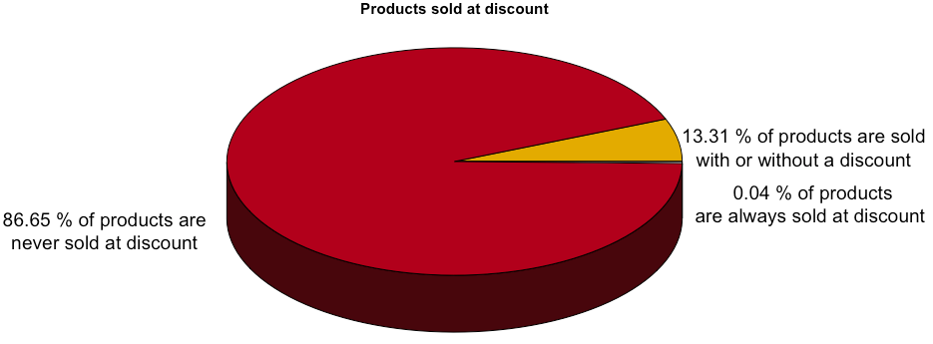
Product Insights
Products lack re-order value
Only 4 products have been re-order by customers in the entire 7 year window
Either products are highly durable, or
Customers do not purchase products again because it doesn't meet their expectations
Products sold at discount
86.65% or 6,932 products were never sold at a discount
Only 3 products were always sold at a discount
No Chart

Slide 15
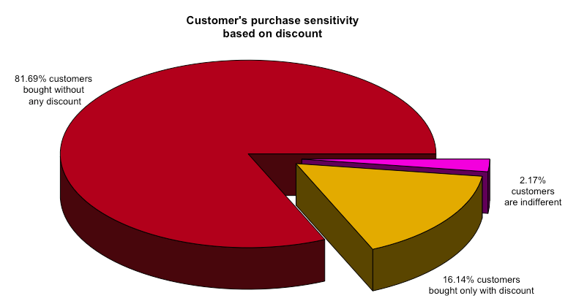
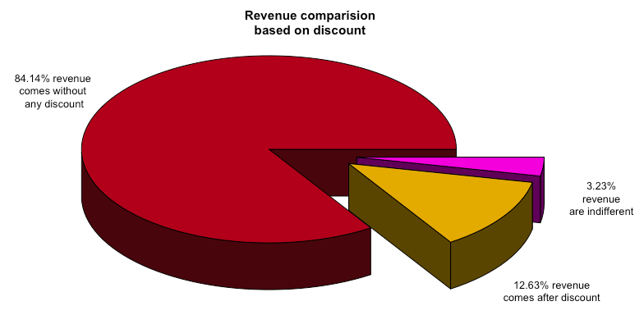
Product Insights (CONT..)
Purchase sensitivity on customers on discount
81.6% of customers bought the product without any discount
16.14% of customers bought a product only at a discounted price
2% of customers were indifferent to discount
Revenue comparison on discount
84.14% of revenue comes from customer who buy without any discount ever
12.63% of revenue comes only customers who buy only when there is discounted sales
3.23% of revenue comes customers who are indifferent

Slide 16
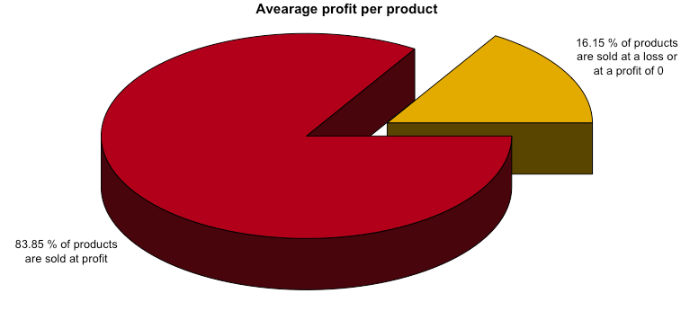
Product Insights (CONT..)
Average profit per product
There are multiple products that are sold at a loss because of the discount
16.15% or 1,292 products are sold at no-profit or loss
The balance of 83.85% or 6,708 products are sold at a profit
Average profit-loss distribution
Profit margin distribution shows:
Most products are sold at an average margin of $5 or less
Several products are sold at a loss with the maximum average loss of $55 loss
Maximum average profit is $122

Slide 17
Customer order Insights
Returning customers
Revenue contribution from customer orders
Purchase patterns for new customers
Purchase patterns for returning customers

Slide 18
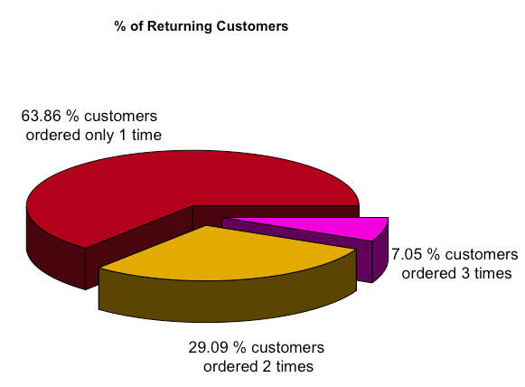
Customer Order Insights
Share of returning customers
63.86% of the customers ordered only 1 time in the entire 7 years time period
No customers ordered more than 3 times
Customers in OMS who have’t purchased yet
We have 19 customers in our Order management System who havenot ordered a product yet
All 19 customers have joined on or after Dec 23rd, 2011 - last 1 week of the period in analysis

Slide 19
Customer Order Insights (CONT..)
Revenue distribution from customers
20% of the customers contributed to less than $190 per customer
50% of the customers contributed to less than $416 per customer
90% of the customers contributed to less than $1123 per customer
Revenue distribution per order per customer
Follows a similar distribution as revenue from customer
20% of the customers contributed to less than $162 per order
50% of the customers contributed to less than $318 per order
90% of the customers contributed to less than $715 per order

Slide 20
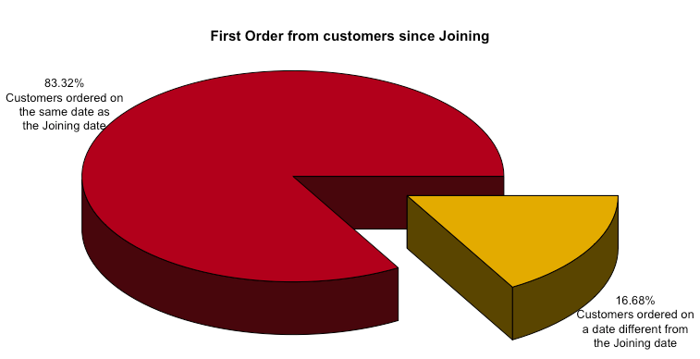
Customer Order Insights (CONT..)
Pattern in a customer’s first order
83.32% of the customers placed their first order on the same date as joining date
The balance 16.68% customers took time to place their first order
This further drill down is shown in the plot on the right hand side:
For a customer who is already on the OMS, the first order will be placed within the first 10 days*
* This covers the 19 customers in OMS who haven’t yet placed any order. They can be expected to place the order within 10 of joining with a probability of 100%

Slide 21
Customer Order Insights (CONT..)
Pattern in a returning customer’s second order
From page 18, 29.09% of customer’s returned for a second order
Most of them returned after 360 days from the date of their first order. This split of when the customer’s returned is shown on the right
Pattern in a returning customer’s third order
From page 18, 7.05% of customer’s returned for even a third order
Similar to the pattern above, most of them returned after 360 days from the date of their second order. This split of when the customer’s returned is shown on the right

Slide 22
Thank YOU

